Slide 1

Safe Business
Making business great again

Slide 2
Safe Business
Het probleem
De oplossing

Slide 3
Earning money
Little company
advertisment
Big company
Investing
Little company
Shares

Slide 4
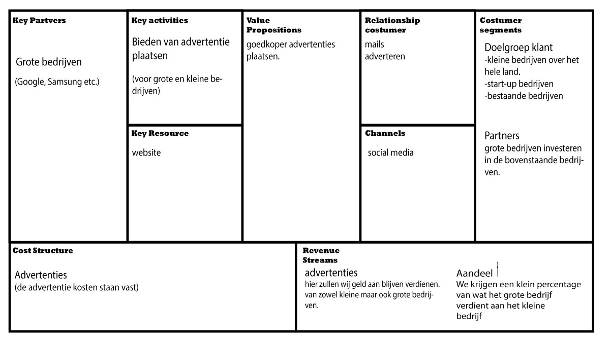
Add a Slide Title - 5
Business Model Canavas

Slide 5
The website itself

